Slide 1
Tool for mapping hybrid vehicle CAN data of on-road fleet testing on GOOGLE maps
Dushyant Kumbhat

Slide 2
Agenda
Mild Hybrid System Overview
Fleet Testing Requirements
CONVENTIONAL approach for Route selection and Analysis
Development of mapping tool using MATLAB
Demo of MAPPING tool
Limitations of Conventional approach
Methodology adopted

Slide 3
Agenda
Mild Hybrid System Overview
Fleet Testing Requirements
CONVENTIONAL approach for Route selection and Analysis
Development of Mapping tool using MATLAB
Demo of MAPPING tool
Limitations of Conventional approach
Methodology adopted

Slide 4

What is a Mild Hybrid System

Slide 5
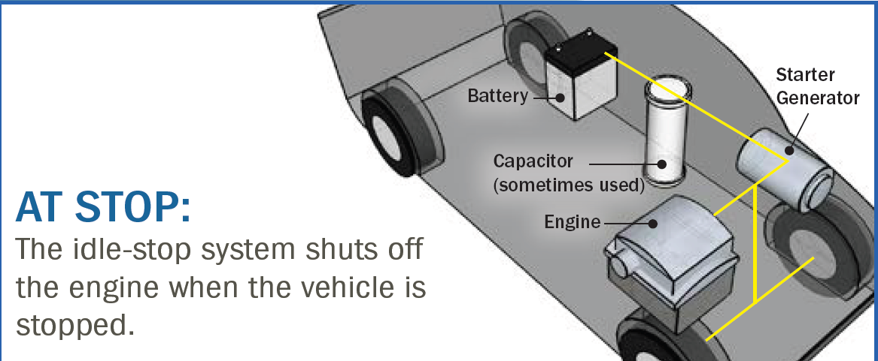
What is a Mild Hybrid System
Mild Hybrid system offers the possibility of fuel saving by deploying Idle start-stop feature

Slide 6
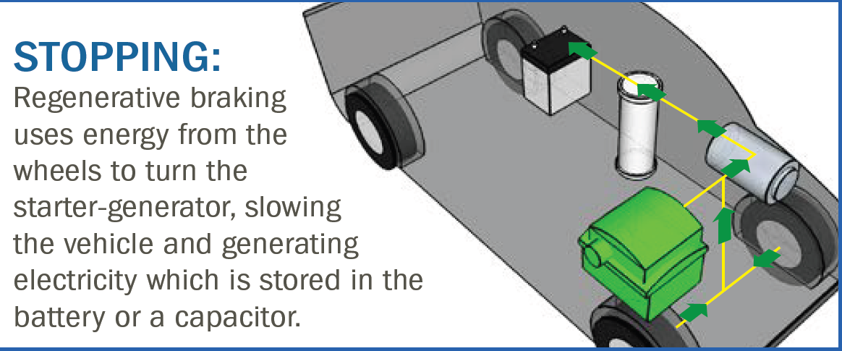
What is a Mild Hybrid System
Mild Hybrid system offers the possibility of fuel saving by deploying Idle start-stop feature and using regenerative braking to store energy in battery

Slide 7
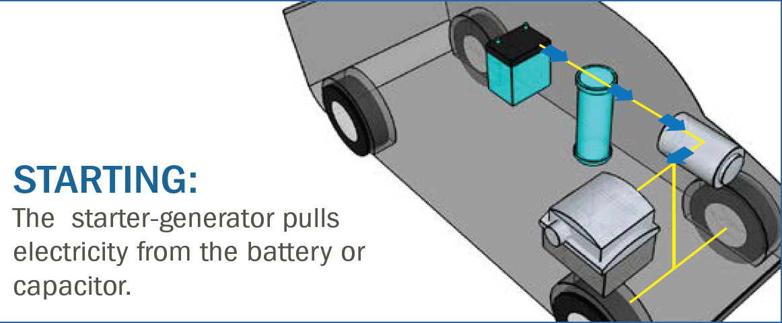
What is a Mild Hybrid System
Mild Hybrid system offers the possibility of fuel saving by deploying Idle start-stop feature and using regenerative braking to store energy in battery and providing this energy back to the engine in form of motor assist whenever required.

Slide 8
What is a Mild Hybrid System
This technology reduces fuel consumption during city driving by 4 to 10% or more, depending on the
Extent of technology used and
Specific driving conditions

Slide 9
Agenda
Mild Hybrid System Overview
Fleet Testing Requirements
CONVENTIONAL approach for Route selection and Analysis
Development of Mapping tool using MATLAB
Demo of MAPPING tool
Limitations of Conventional approach
Methodology adopted

Slide 10

Fleet Testing Requirements
For gauging the actual On Road Potential of
Idle start stop
Regeneration
Assist
On-road Fleet testing for Different City Traffic conditions and Different Routes becomes integral part of development cycle of such system

Slide 11
Agenda
Mild Hybrid System Overview
Fleet Testing Requirements
Conventional approach for Route selection and Analysis
Development of Mapping tool using MATLAB
Demo of MAPPING tool
Limitations of Conventional approach

Slide 12
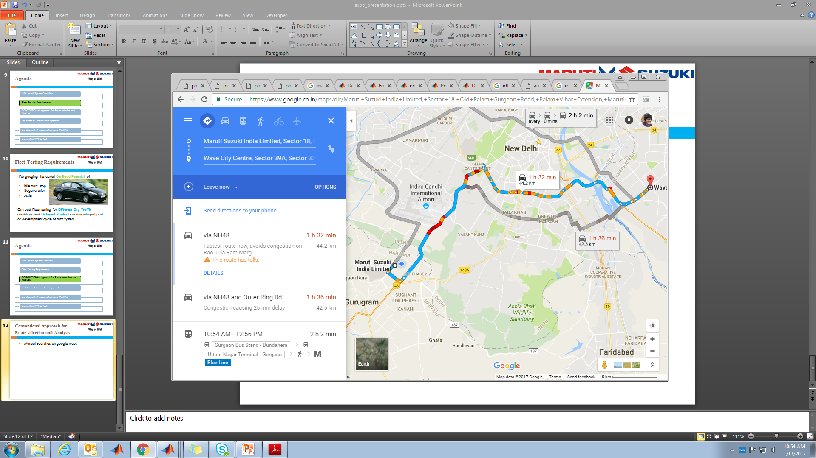
Conventional approach for Route selection
Using google maps and past experience

Slide 13
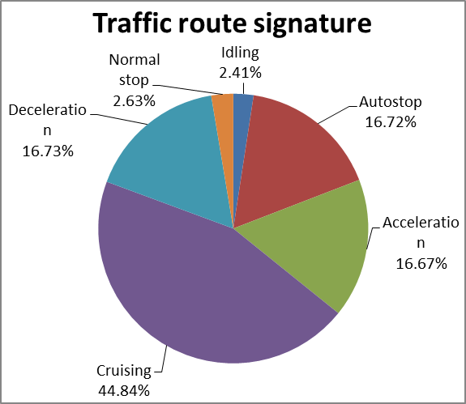
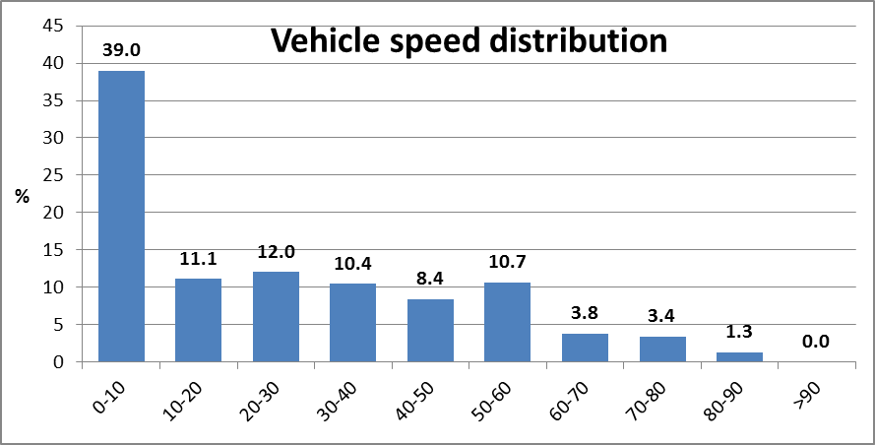
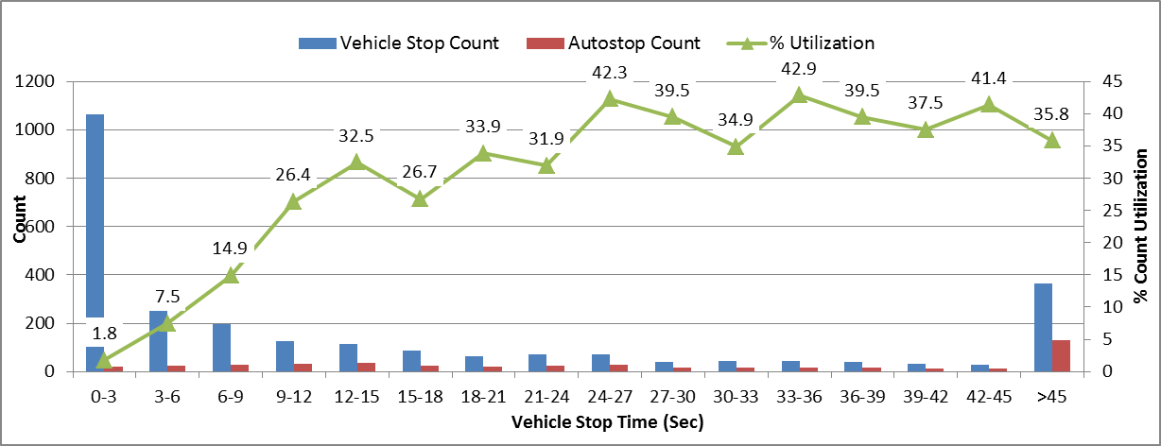
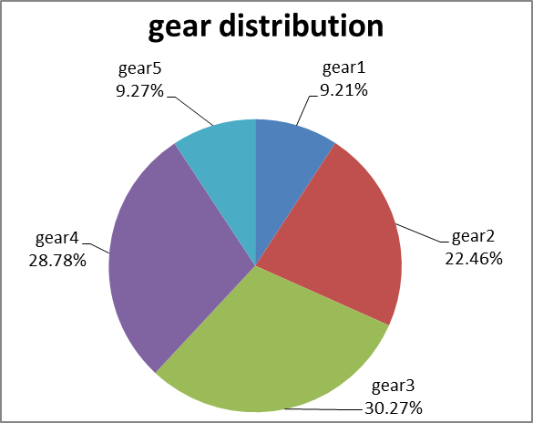
Conventional approach for Route Analysis
Histograms and other charts for visualization

Slide 14
Agenda
Mild Hybrid System Overview
Fleet Testing Requirements
CONVENTIONAL approach for Route selection and Analysis
Development of Mapping tool using MATLAB
Demo of MAPPING tool
Limitations of Conventional approach
Methodology adopted

Slide 15




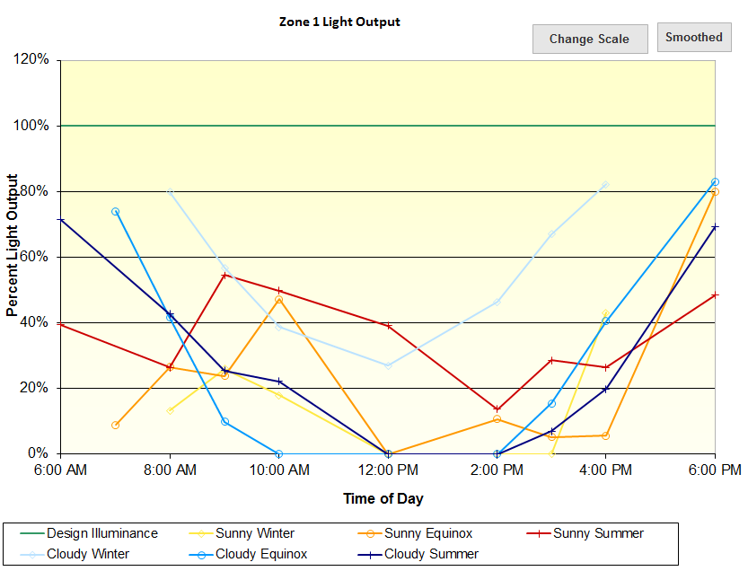
Limitations of Conventional Approach
Poor visualization for studying impact of different routes and traffic conditions on system
Correlation of System performance with changing routes is difficult to study

Slide 16
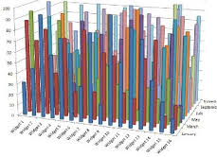
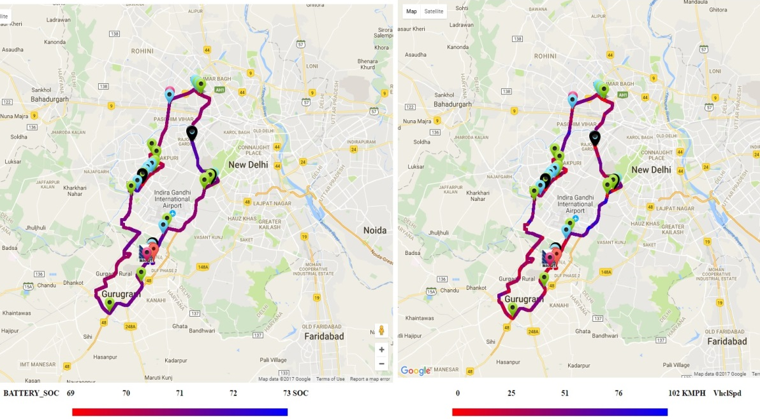
Limitations of Conventional approach
Averaging out of data when entire route data plotted on excel charts i.e. Exclusivity loss for system performance under short intermittent traffic conditions
No mechanism available for mapping acquired data on maps

Slide 17
Agenda
Mild Hybrid System Overview
Fleet Testing Requirements
CONVENTIONAL approach for Route selection and Analysis
Development of Mapping tool using MATLAB
Demo of MAPPING tool
Limitations of Conventional approach
Methodology adopted

Slide 18
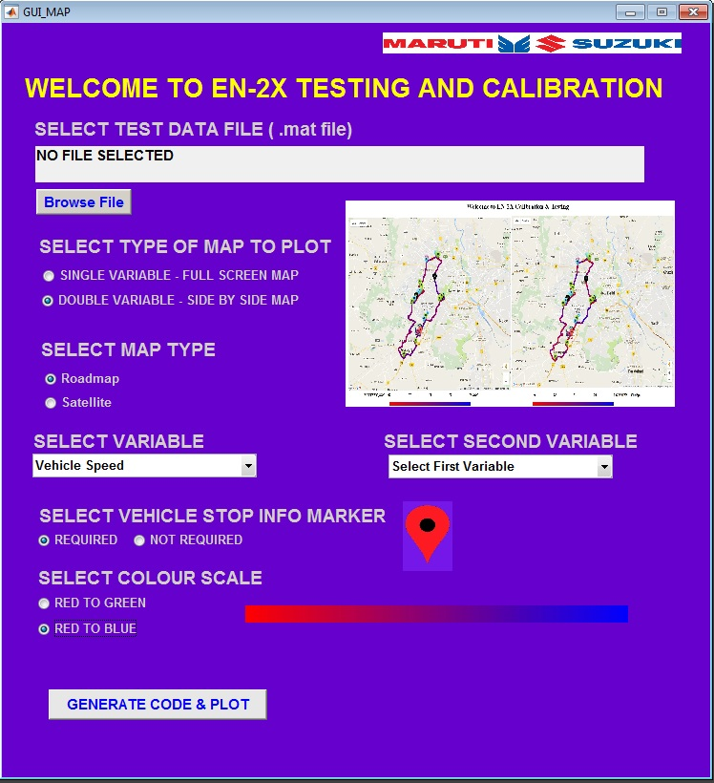
Development of Mapping tool using MATLAB
A GUI based standalone application for mapping data on google maps was developed using MATLAB
It lets user select the test data file along with few others options for mapping and customization

Slide 19
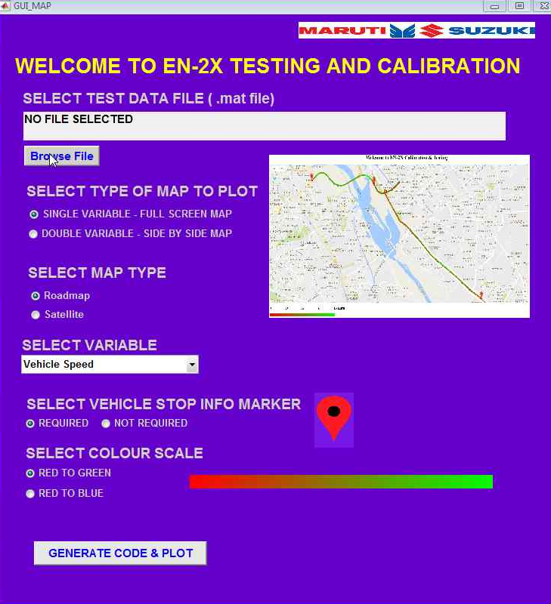
USING MAPPING TOOL
STEP 1:-
Browse the test data file

Slide 20
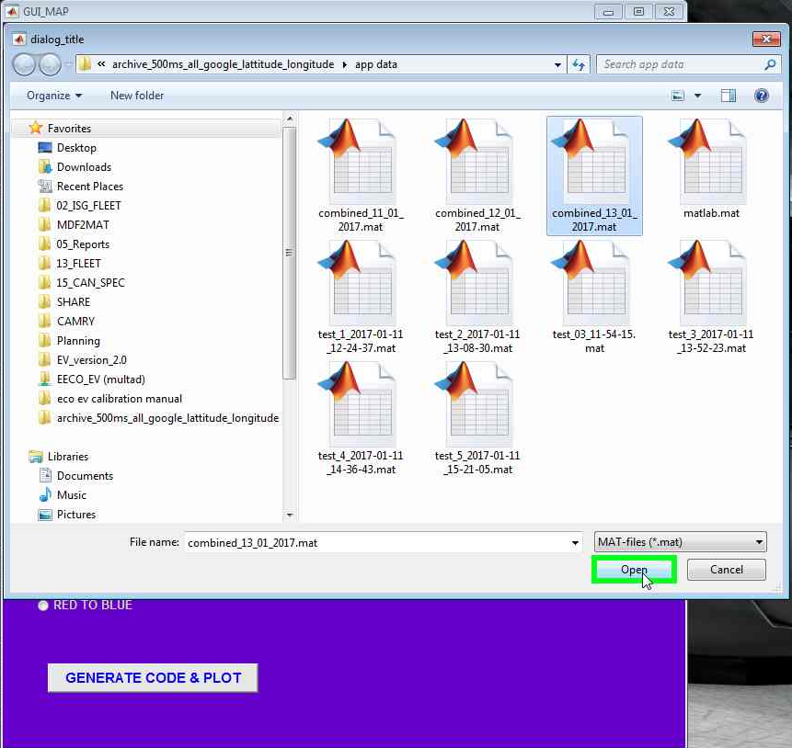
USING MAPPING TOOL
STEP 1:-
Browse the test data file

Slide 21
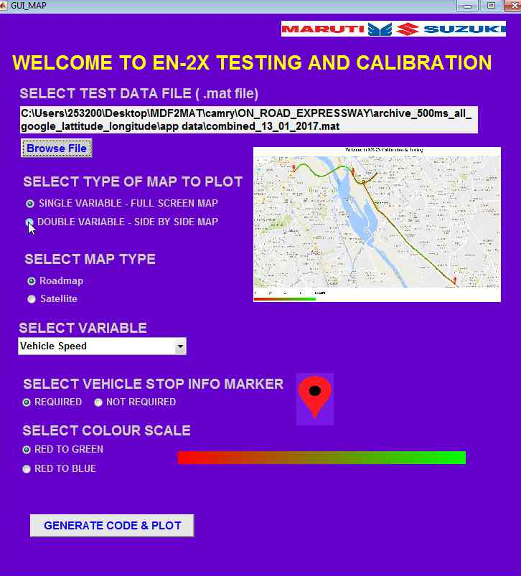
USING MAPPING TOOL
STEP 2:-
Select whether single variable or double variable to be plotted

Slide 22
USING MAPPING TOOL
STEP 3:-
Select MAP TYPE
Roadmap or Satellite

Slide 23
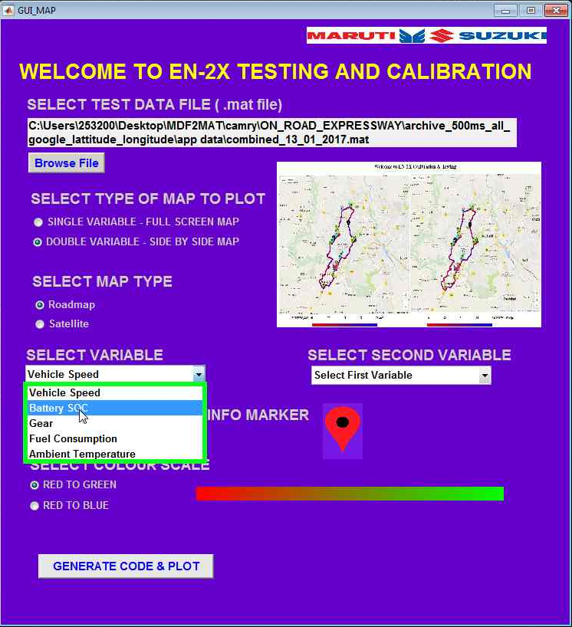
USING MAPPING TOOL
STEP 4:-
Select First variable

Slide 24
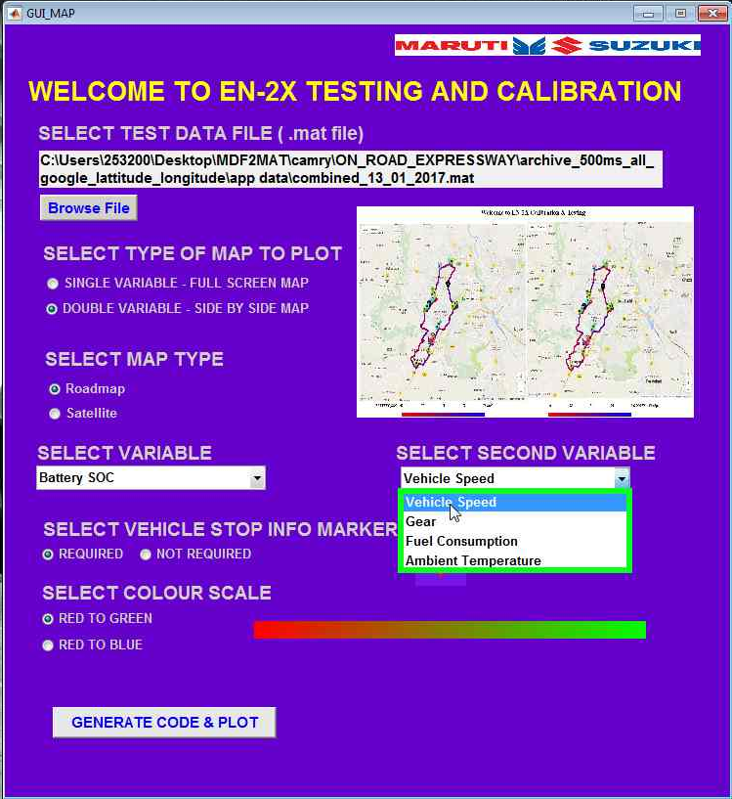
USING MAPPING TOOL
STEP 5:-
Select Second variable

Slide 25
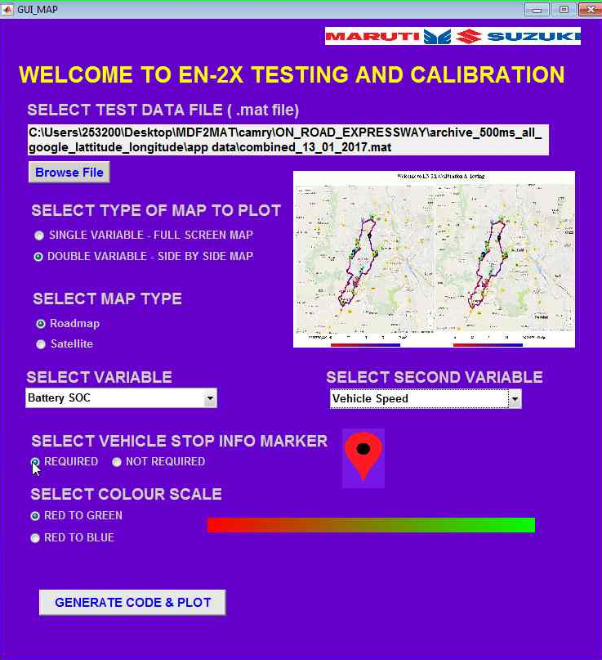
USING MAPPING TOOL
STEP 6:-
Select whether vehicle stop info markers required or not

Slide 26
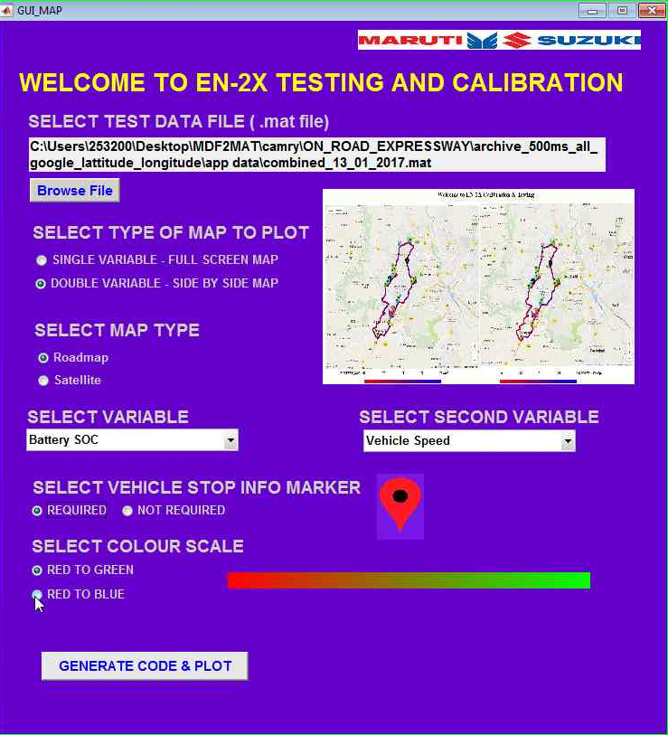
USING MAPPING TOOL
STEP 7:-
Select Colour Scale

Slide 27


USING MAPPING TOOL
STEP 8:-
You’re done now !!
CLICK

Slide 28
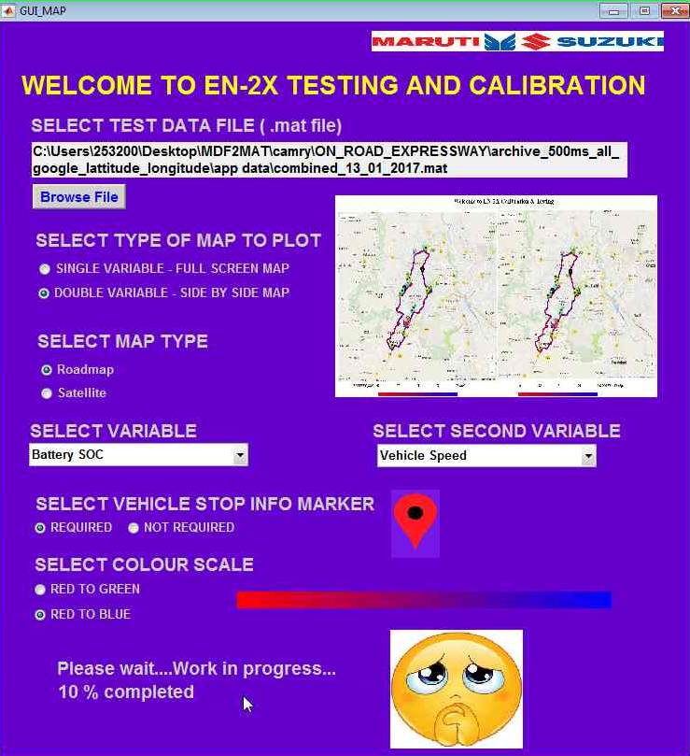
USING MAPPING TOOL
STEP 9:-
Just wait for the application to finish writing HTML code and ping to GOOGLE servers.

Slide 29
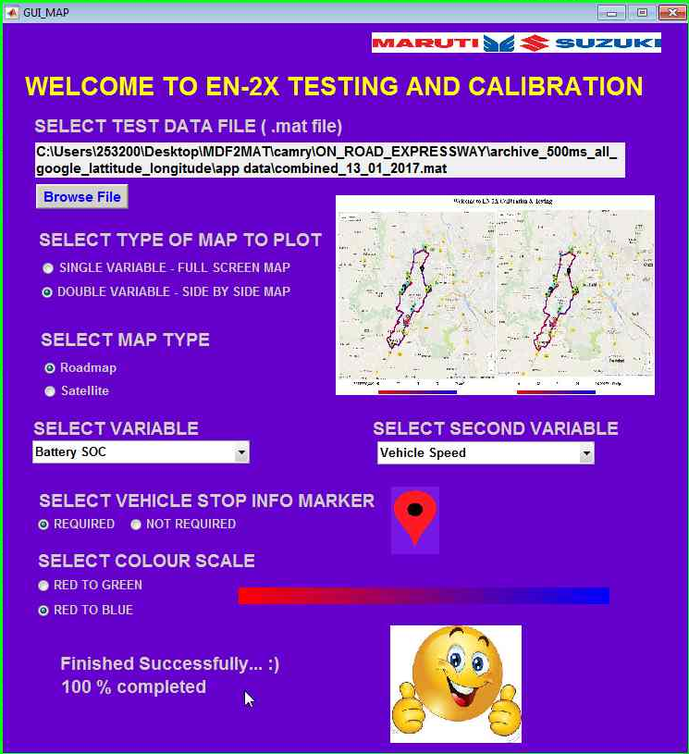
USING MAPPING TOOL
STEP 9:-
Just wait for the application to finish writing HTML code and ping to GOOGLE servers.

Slide 30
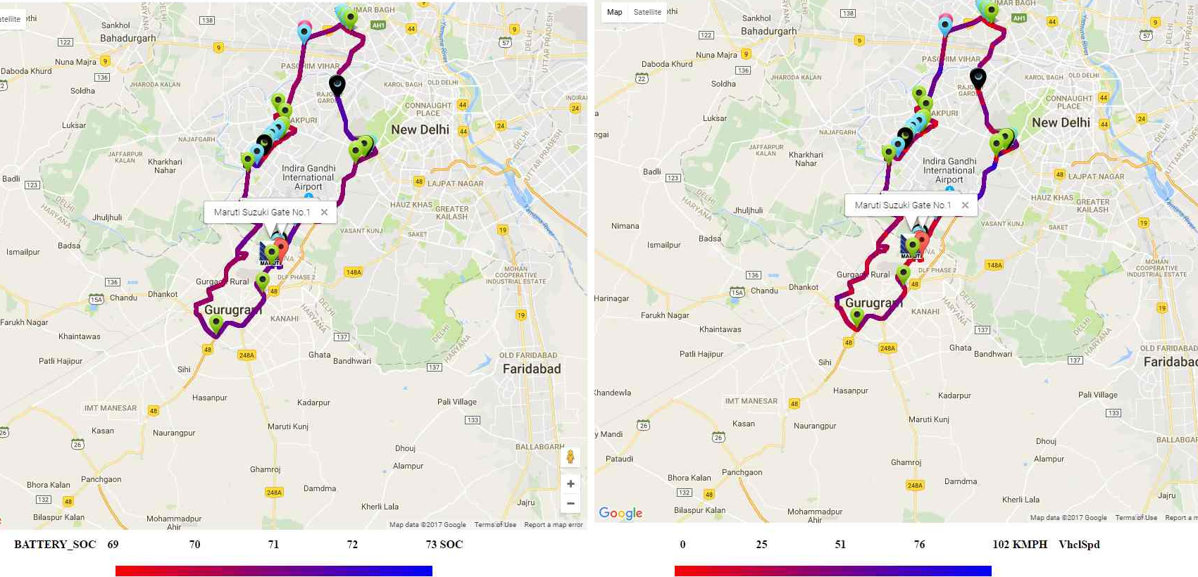
USING MAPPING TOOL
STEP 10:-
Once the HTML code is generated, it will open the browser to view the final plot

Slide 31
Agenda
Mild Hybrid System Overview
Fleet Testing Requirements
CONVENTIONAL approach for Route selection and Analysis
Development of Mapping tool using MATLAB
Demo of MAPPING tool
Limitations of Conventional approach
Methodology adopted

Slide 32
Methodology Adopted
MAPPING Tool – user input and selection of test file
Using MATLAB, Generation of HTML code using GOOGLE MAPS API and USER input
Request query to GOOGLE and wait for the response
Fleet testing and Data Acquisition
Pre-Processing and time sampling on selected data using MATLAB

Slide 33
Agenda
Mild Hybrid System Overview
Fleet Testing Requirements
CONVENTIONAL approach for Route selection and Analysis
Development of Mapping tool using MATLAB
Demo of MAPPING tool
Limitations of Conventional approach
Methodology adopted

Slide 34
Demo
Plotting Tool Demo

Slide 35

Questions and Discusions

